Slide 1
Platforms regulation
The Digital Markets Act
Léa Quertemont, François Tonglet
& Aline Nardi

Slide 2
Plan
1
3
Context
Solution
2
4
Problems
Process

Slide 3
1. Context
Big techs ?
Leaders ?
Disruptors ?
Incumbents ?

Slide 4
Online platforms are …
Key enablers of digital trade
Around 60% of private consumption of goods and services are transected via online intermediaries
Around 30% of public consumption of goods and services are transected via online intermediaries
1 million EU enterprises trade through online platforms

Slide 5
2. Problems
High market concentration
Strong network effects
High return to the use of data
Consumer inertia
Market tipping

Slide 6
2. Problems
Room for only one or two players
High barriers to entry

Slide 7
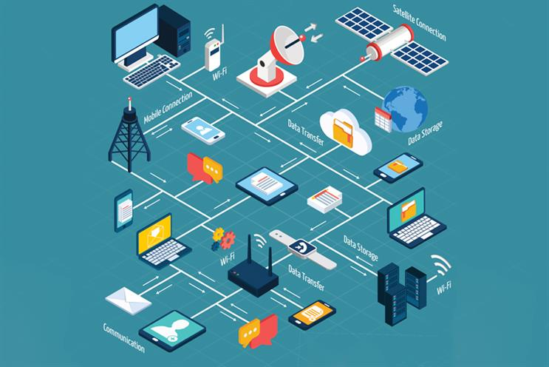
Furthermore, creating ecosystems ...

Slide 8
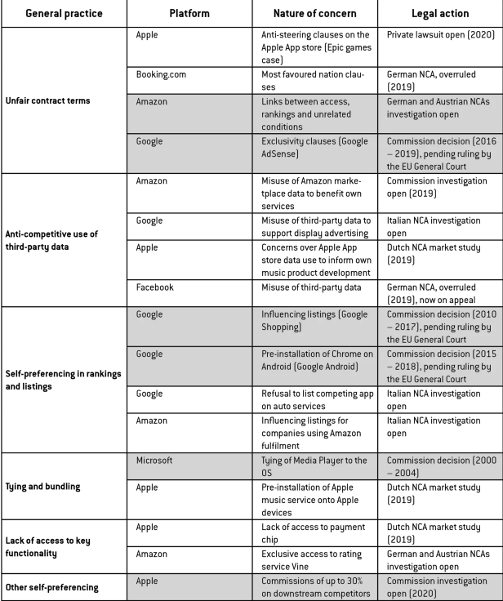
Success is not a problem … what you do with it is
https://www.bruegel.org/blog-post/regulating-big-tech-digital-markets-act

Slide 9
Success is not a problem … what you do with it is
Higher prices
Lower quality
Less choice for EU consumers
Less innovation

Slide 10
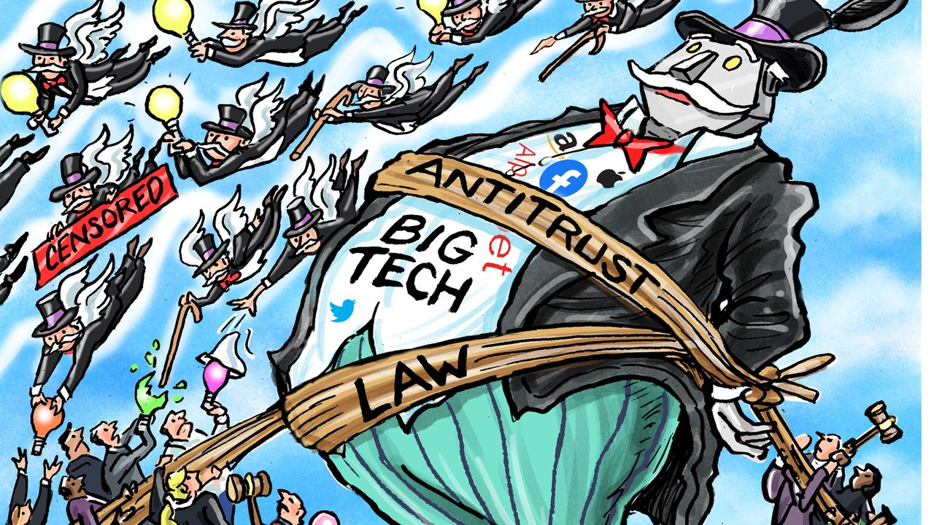
What is the current situation in the EU ?

Slide 11
What is the current situation in the EU ?
Antitrust
Ex post (after the damage is done)
Time consuming
Not always fit to the digital economy
Case-by-case analysis
Can be adapted to business models
Slow-moving competition policy tools not well-equipped to address digital concerns

Slide 12
What can be done ?
Need for a regulatory initiative
If left to the Member states, would lead to a fragmentation of the Single Market
A common set of rules for Big Tech will foster ...
Innovation
Growth
Competitiveness

Slide 13
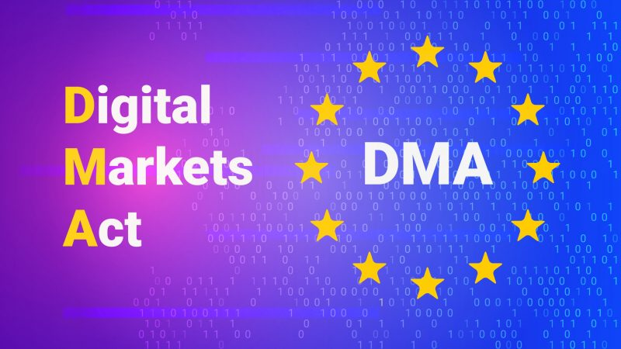
3. Solution : the DMA
What is the DMA ?
New European legislation on digital markets
Proposed In December 2020 alongside the Digital Services Act (DSA) by the European Commission
Came into force on the first of November 2022
Regulate the gatekeepers of the digital world by imposing direct restrictions on the behavior of tech giants

Slide 14
Main goals of the DMA
"The DMA will profoundly change the digital landscape. With this rule, the European Union is taking a proactive approach to ensure fair, transparent and contestable digital markets".
A
Reduce barriers to entry to digital markets
B
Fight anti-competitive practices
Margrethe Vestager, Executive Vice President of the European Commission
innovation, growth and competitiveness, both in the European single market and globally.

Slide 15
The DMA aims to establish rules of conduct regarding economic and anti-competitive behavior. These rules apply only to gatekeepers
Then, what is a Gatekeeper ?
A company providing essential platform services.
3 cumulative conditions
Once the company is qualified as a gatekeeper, new rules will impose obligations on them
The violation of their obligations will lead to heavy sanctions

Slide 16
Benefits of the DMA
For SME's (small and medium-sized enterprises) :
Business users who depend on gatekeepers to offer their services in the single market will have a fairer business environment.
Innovators and technology start-ups will have new opportunities to compete and innovate in the online platform environment without having to comply with unfair terms and conditions limiting their development.

Slide 17
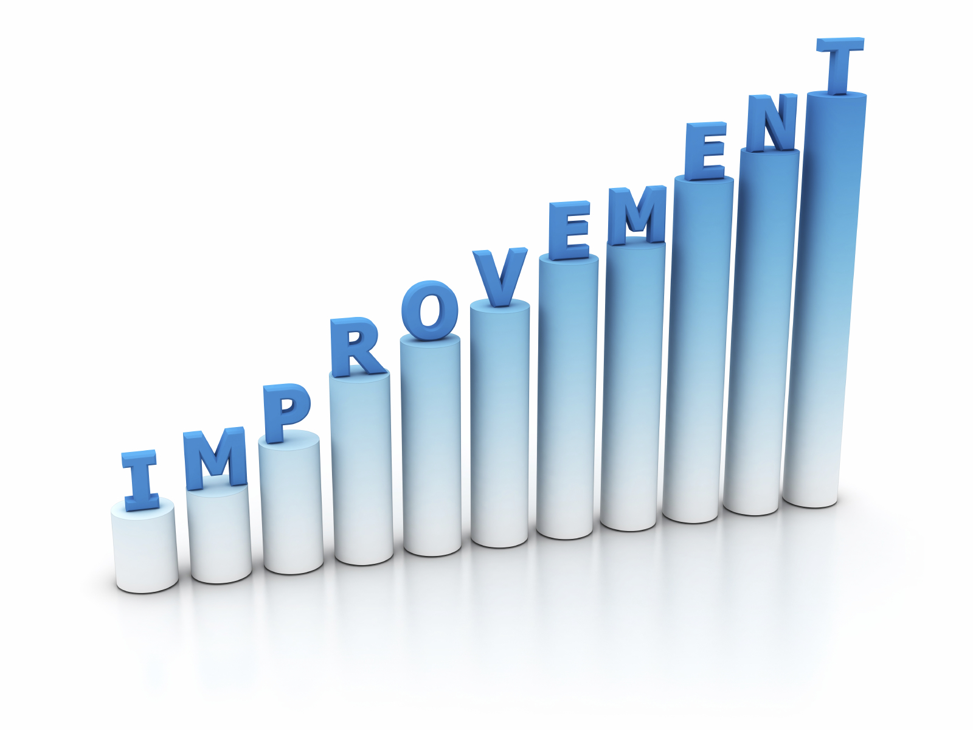
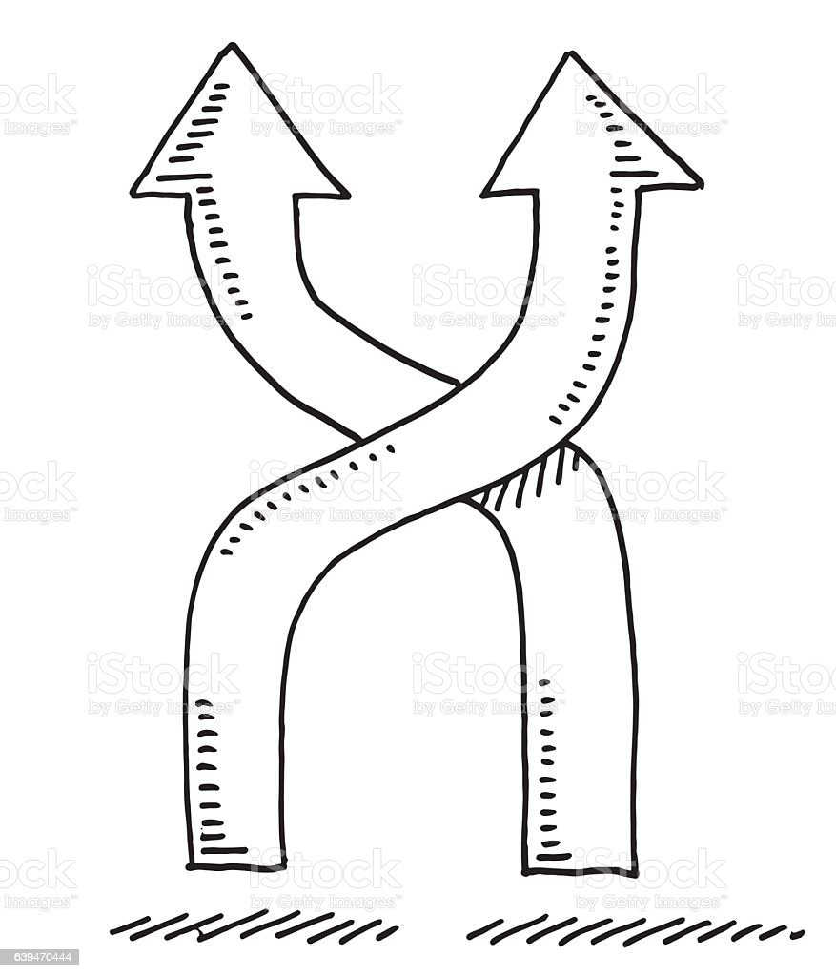
Benefits of the DMA
For the consumers :
keep control over their personal data
Consumers will have more and better services to choose from, more opportunities to switch their provider if they wish so, direct access to services, and fairer prices.
E.g. : Interoperability

Slide 18
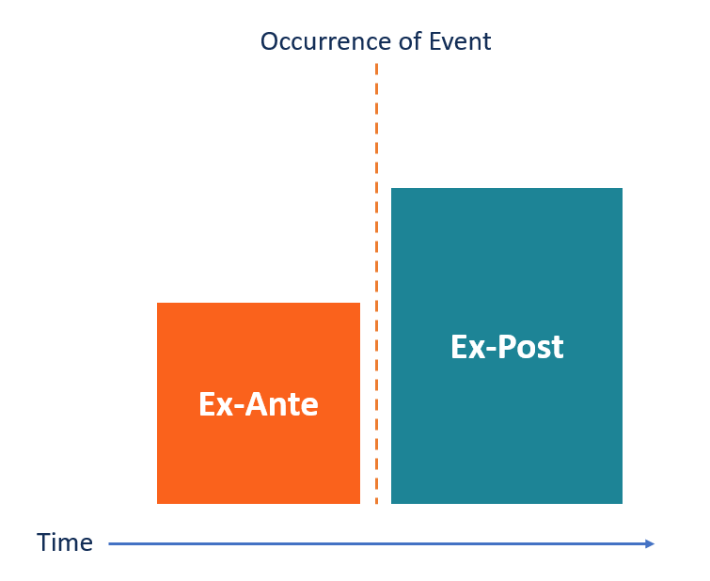
Benefits of the DMA
Overall benefits :
Ensure fair and open digital markets. Gatekeepers will keep all opportunities to innovate and offer new services. They will simply not be allowed to use unfair practices towards the business users and customers
Ex-ante regulation

Slide 19
3. Solution : the DMA
Scope
2 important concepts :
Gatekeepers
Core platform services
3 objective criteria :
strong economic position, significant impact on the internal market
strong intermediation position, links a large user base to a large number of businesses
durable position in the market : strong and sustainable position
List (art, 2, 2, DMA) :
online intermediation services; online search engines; online social networking services; video-sharing platform services; number-independent interpersonal communications services; | (f) operating systems; (g) web browsers; (h) virtual assistants; cloud computing services; (j) online advertising services,

Slide 20
3. Solution : the DMA
Examples of do’s and don’ts
Interoperability related obligations
Data access and data portability
Allow third party app stores
Allow business users to promote their offer and conclude contracts with their customers outside the gatekeeper’s platform
No self preferencing
No lock-in
No cross-tying
No cross-tracking without effective consent
No spying on businesses’ customers
Protecting multiple prices and terms

Slide 21
3. Solution : the DMA
Consequences of non-compliance
Fines | up to 10% of the company’s total worldwide annual turnover, or up to 20% in the event of repeated infringements
Period penalty payments | up to 5% of the average daily turnover
Remedies | In case of systematic infringement : additional remedies after a market investigation if necessary, behavioural and structural remedies (e.g. divestiture)

Slide 22
4. Process
A. The DMA’s timeline
15th December 2020
First proposal by EC of DMA
25th of March 2022
Political agreement on the DMA
1st November 2022
Entry into force of the DMA
2nd May 2023
By 2nd July
Application of (most of) the DMA provisions
Gatekeeper designation procedure
By 2024
Compliance of gatekeepers with the DMA
12th October 2022
Publication of the DMA in the Official Journal

Slide 23
4. Process
B. The DMA’s legal basis
“Having regard to the Treaty on the Functioning of the European Union, and in particular Article 114 thereof,”
Article 114 TFEU → enables the EU to adopt measures to harmonize Single Market
Why does it matter ?
Ban on national regulation
within the scope of, and
which pursues the same objectives as the DMA
Regulation by EU
Regulation = binding legislative act which must be applied in its entirety across the EU
Gatekeepers are international in nature
Without the DMA → disparities between competitive conditions for the users, to the detriment of integration of the Single Market

Slide 24
4. Process
C. What's next ?
Dynamic nature of platform economy → DMA provides for constant monitoring
What does it entail ?
monitoring on scope-related issues ;
E.g. criteria for the designation of gatekeepers, evolution of the designation of gatekeepers, use of the qualitative assessment in the designation process
monitoring of unfair practices ; and
E.g. compliance, enforcement patterns, evolution
monitoring as a trigger for the launch of a market investigation with the purpose of examining new core platform services and practices in the digital sector.

Slide 25
Thank you!

